Slide 1
Slip in polycrystal
Although the basic slip mechanisms are the same in polycrystals and single crystals, their stress-strain behavior differs substantially.
The grips of a testing machine provide constraints on single crystal deformation, so do adjacent grains within a polycrystal provide similar constraints in polycrystalline deformation.

Slide 2
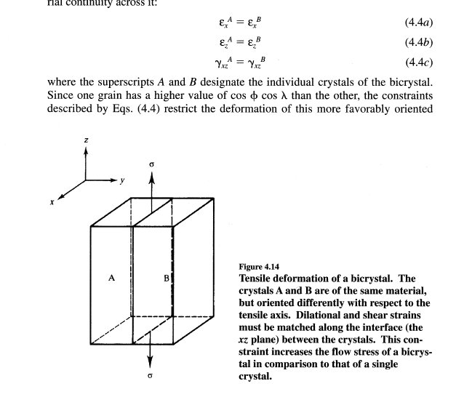
Deformation of Bi-Crystal

Slide 3
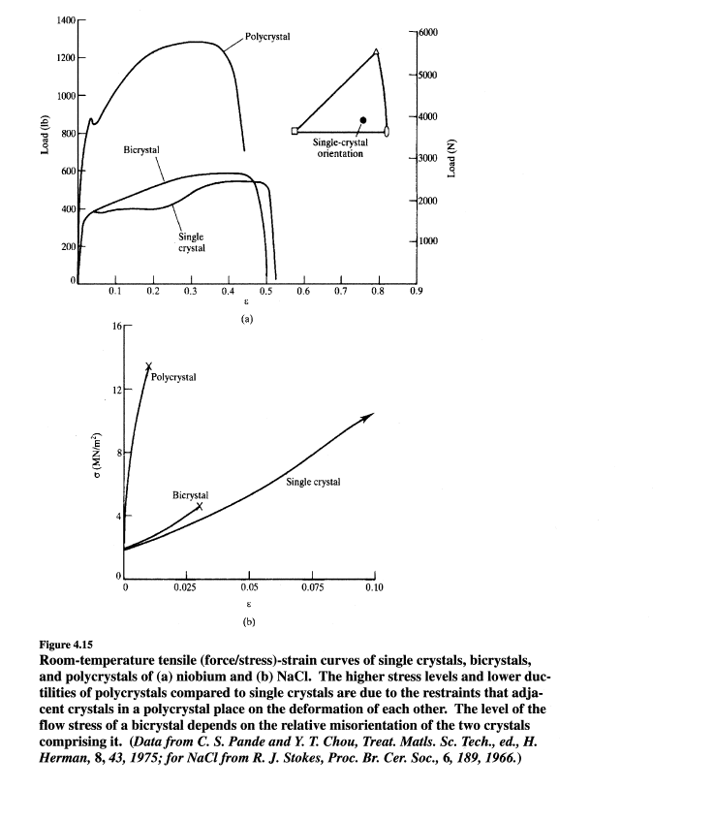

Slide 4
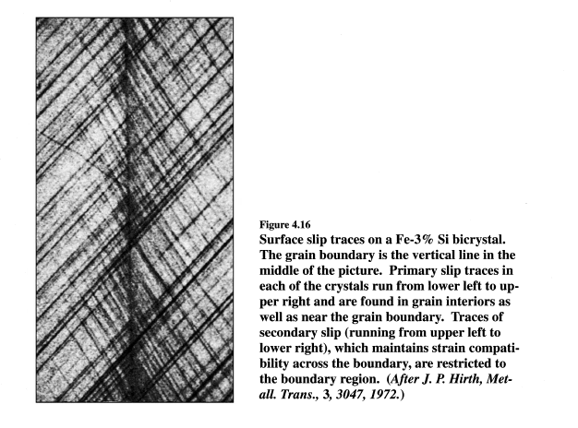

Slide 5
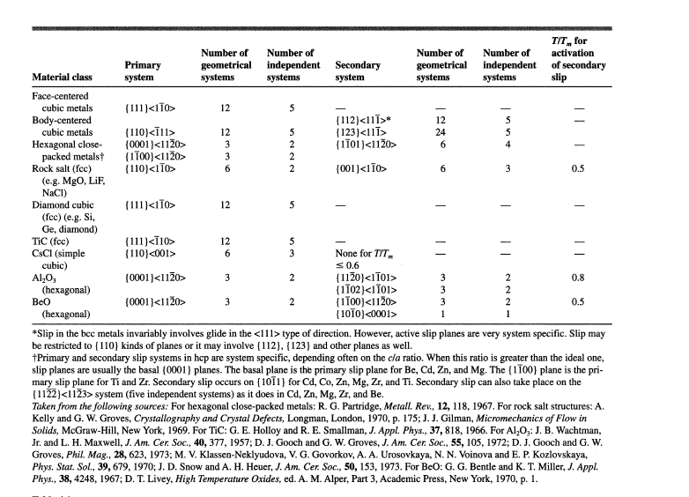
The number of independent slip systems is related to, but not equal to, the number of geometrical slip systems. An independent slip system is one for which slip displacements on it can not be duplicated by a combination of displacements on other slip systems. The maximum number independent slip system can not be more than 5

Slide 6
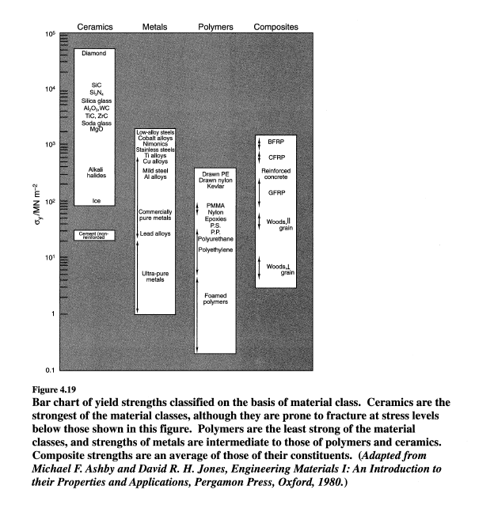

Slide 7
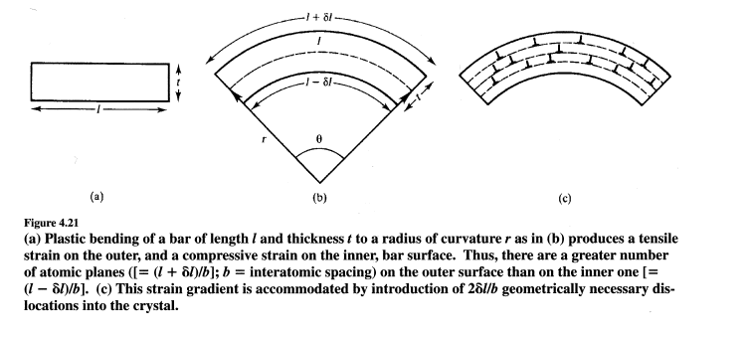
GEOMETRICALLY NECESSARY DISLOCATIONS (GND)
Geometrically Necessary Dislocations (GNDs) are the dislocations required to accommodate non-uniform plastic deformation and maintain lattice continuity. They play a major role in strain hardening, size effects (smaller is stronger), and grain boundary mechanics
When a crystal deforms, dislocations move to accommodate strain.
If the strain is uniform, dislocations can balance out, leaving no net distortion.
But when there is non-uniform (inhomogeneous) plastic deformation, the crystal lattice bends or rotates.
To maintain compatibility of deformation and preserve lattice continuity, extra dislocations are required these are called Geometrically Necessary Dislocations.
Example:
Indentation, bending etc

Slide 8
Statistically stored dislocation (SSD):
Statistically stored dislocations are dislocations that are generated during plastic deformation randomly in pairs of opposite sign, such that they do not produce a net lattice curvature
They result from the statistical trapping of dislocations (during solidification, random interactions, obstacles, forest dislocations etc)
Examples:
Uniaxial tension/compression: dislocations multiply and entangle, but since strain is uniform, they form SSDs.
Slip band formation: many dislocations pile up statistically, not necessarily producing misorientation.

Slide 9
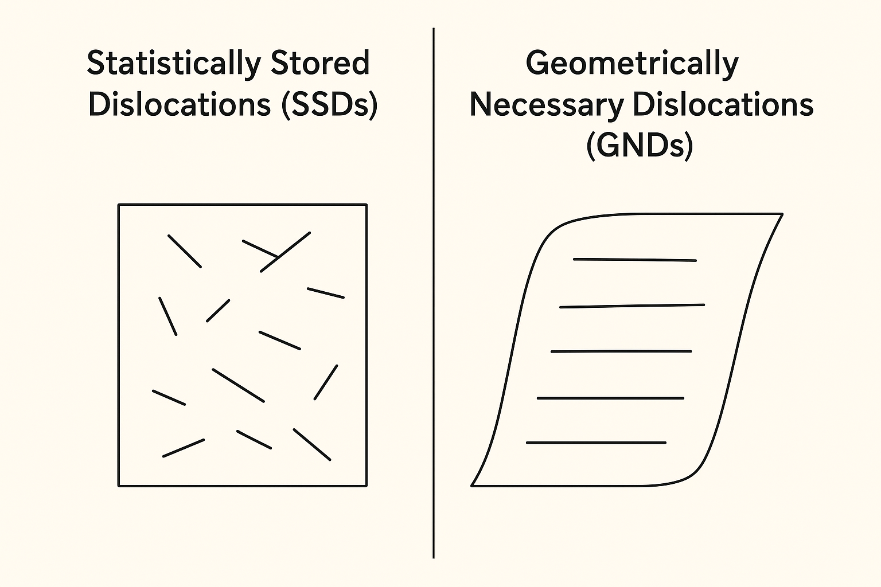

Slide 10
Strengthening mechanism
In this, we consider important ways by which the flow strength of crystalline solids is increased by restricting dislocation motion. Various types of "obstacles,“ either alone or in combination, can be present in a crystalline material to produce such an effect.
The most commonly employed obstacles are other dislocations, internal boundaries (such as grain, sub-grain, or cell boundaries), solute atoms, and second-phase particles.
Additional dislocations generated during plastic deformation give rise to work hardening. Material strength increases owing to the decrease in dislocation mobility concurrent with an increase in dislocation population.
Grain boundary strengthening
Solid solution strengthening/Interstitial strengthening
Precipitation/particle strengthening
Work (strain) hardening
Dispersion strengthening
Phase transformation strengthening
Twin/grain boundary engineering
Strain gradient strengthening (size effect)
Defect/radiation-induced strengthening

Slide 11
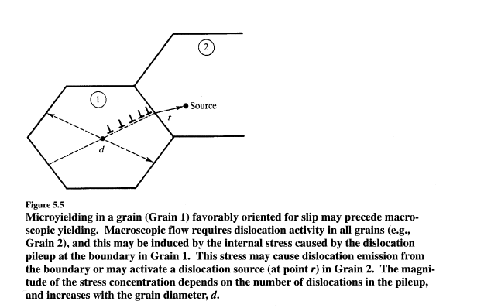
Grain boundary strengthening:
Internal boundaries present obstacles to dislocation motion. On geometrical considerations alone, boundaries are expected to provide stronger obstacles to dislocation motion than line defects (i.e., dislocations) or point defects (e.g., solute
atoms), since the intersection of a surface with a slip plane is a line rather than a point.
σy​ = yield strength
σ0​ = lattice friction stress (intrinsic resistance)
k = Hall–Petch slope (material constant)
d = average grain diameter
Hall-Petch equation and its prediction that the yield strength of a polycrystal increases linearly with d^{-1/2} has been substantiated in a
number of materials.

Slide 12
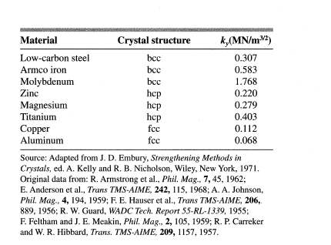

Slide 13
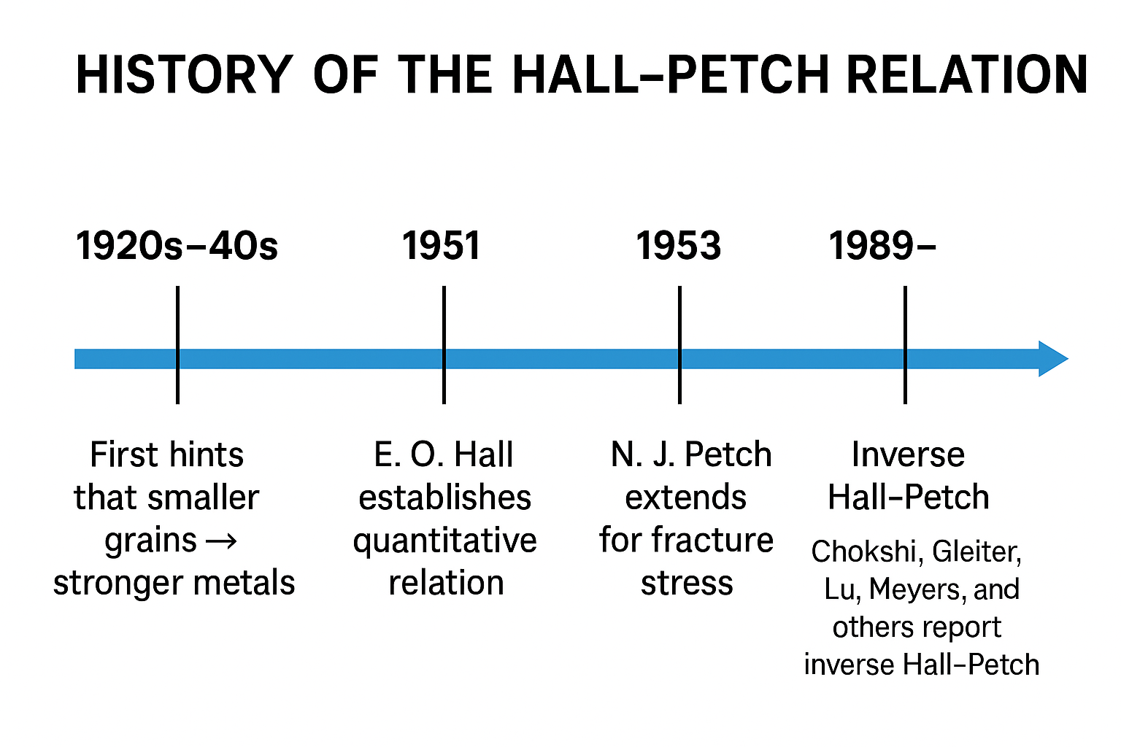
At extremely small grain sizes (<10–15 nm), the Hall–Petch relation breaks down, and materials may soften (inverse Hall–Petch effect), as grain boundary sliding, grain rotation and diffusion becomes dominant

Slide 14
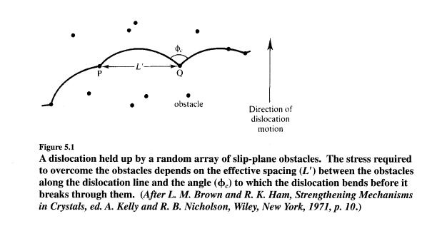

Slide 15
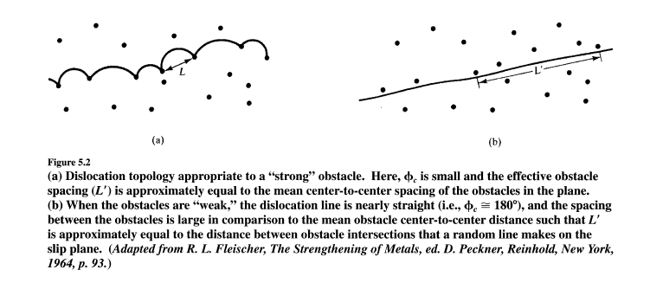

Slide 16
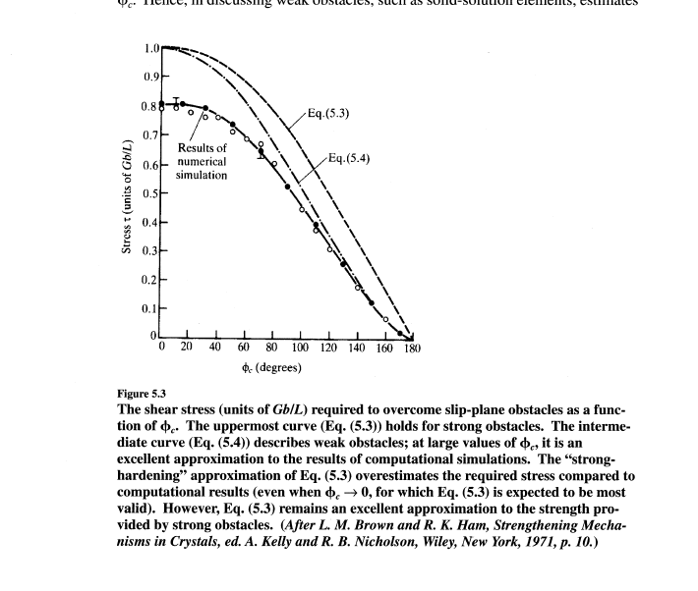
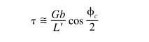

Slide 17
SOLID-SOLUTION STRENGTHENING:
Solute atoms increase the yield strength of crystalline materials. This is a result of the interactions that take place between a moving dislocation and solute atoms. Since the dislocation stress field is a long-range one, solute atoms located both on
the slip plane and above or below it interact with dislocations. However, since the maximum interaction is experienced with those atoms lying in close proximity to the glide plane, it is only these that need be considered in estimating the increase in
material yield strength arising from the presence of the solute atoms.
1. Interstitial solute atoms
2. Substitutional solute atoms
Introduction of a substitutional solute atom into a crystal produces a lattice dilation that typically gives rise to a spherically symmetric stress field around the solute. If the solute atom has an atomic size less than the host (solvent) atom, the dilation is negative (i.e., the atomic volume is locally decreased in the solute atom’s vicinity) and vice versa.

Slide 18
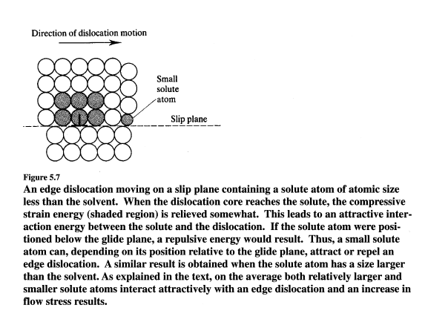

Slide 19
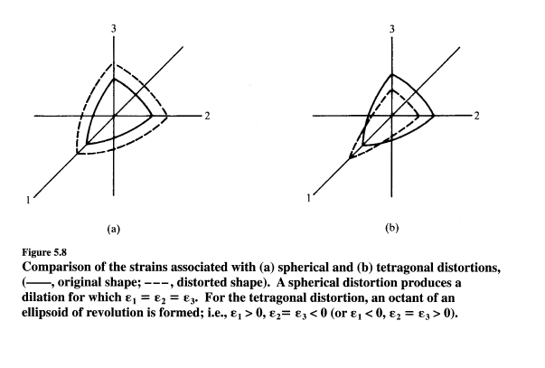
Spherical distortion
Tetragonal distortion

Slide 20
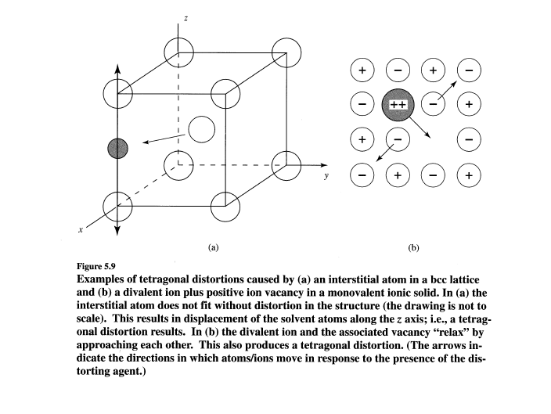

Slide 21
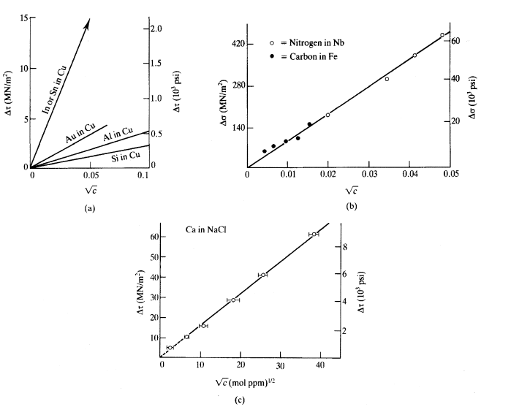
The C^{1/2}dependence of solid-solution hardening is verified for (a) the increase in critical resolved shear stress for a Cu alloy single crystal hardened by substitutional atoms (spherical distortions), (b) the tensile
yield stress increase due to interstitials in Fe and Nb (tetragonal distortions), and (c) the increase in critical resolved shear stress due to the presence of divalent Ca ions in NaCI (tetragonal distortions). Tetragonal distortions harden materials to a much greater degree than do spherical ones. (Datafor (a)from R. L Fleischer, Acta Metall., 11,203, 1963; J. O. Linde and S. Edwards, Arkiv Fysik, 8,511, 1954; and T. J. Koppenal and M. E. Fine, Trans. TMS-AIME, 224, 347, 1962. For (b) from C. Wert, Trans. TMS-AIME, 188, 1242, 1950 and P. R. V. Evans, J. Less Common Metals, 4,78,1962. For (c)fromA. G. Evans and T. Langdon, Prog. Matis. Sc., 21, 171, 1976.)

Slide 22
Particle Hardening/Precipitation Hardening
Small particles of a second phase dispersed in a matrix, these particle impede the dislocation motion therefor increases the yield strength can markedly increase the matrix yield strength even when the dispersoid volume fraction is low
These particle can be added externally or form within the metal matrix during heat treatment.
The degree of strengthening provided by a particle dispersion depends on a number of factors. These include the particle size and volume fraction (L, the mean particle separation distance, is defined if particle size and volume fraction are specified), particle shape, and the nature of the boundary between the particle and the matrix.

Slide 23
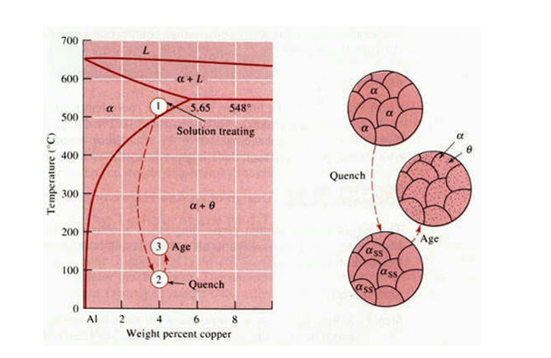
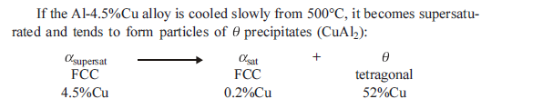
Precipitation in Al-4.5 Cu alloy

Slide 24
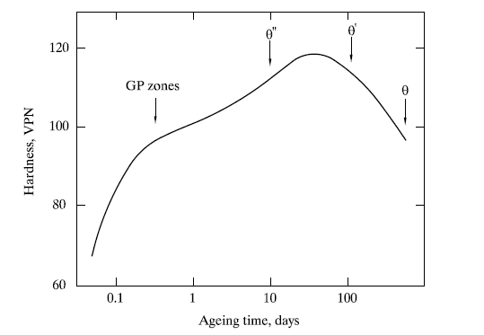

Slide 25
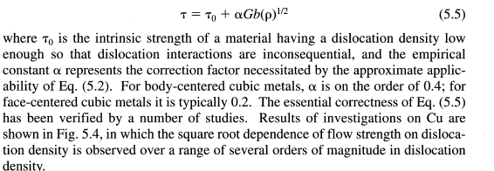
Work hardening:
The increase in dislocation density accompanying continued plastic deformation is responsible for work hardening; that is, dislocations themselves are obstacles to dislocation motion.
Depending on the type of interaction that takes place among moving dislocations, dislocations can be either soft or hard obstacles.
Interaction of stress field of moving dislocation in parallel slip plane soft obstacle
Intersection of moving dislocation is hard obstacle

Slide 26
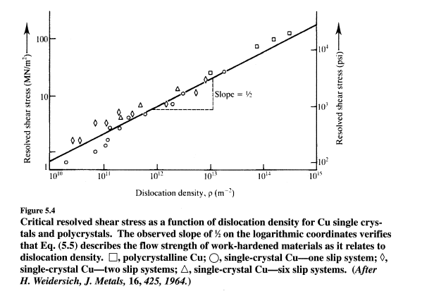

Slide 27
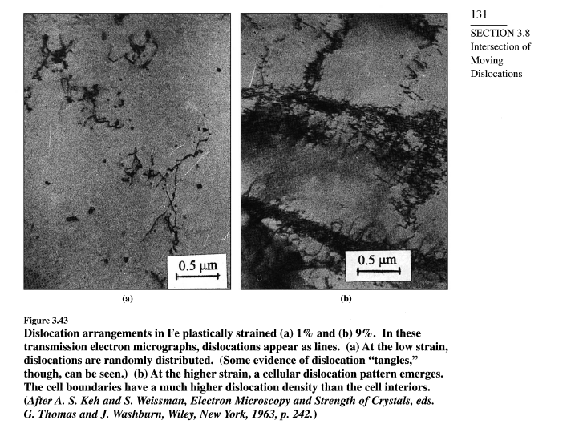

Slide 28
Source of Dislocation:
Grain boundary (Dislocations can nucleate at grain boundaries due to stress concentration and lattice mismatch as well as
boundary sliding and incompatibility also generate new dislocations
Surface Irregularities / Stress Concentrators (Local stress at these sites can reach levels sufficient to nucleate dislocations)
Interface Misfit (Heterogeneous Interfaces) :(At interfaces between phases (e.g., precipitate/matrix, film/substrate),
lattice mismatch causes misfit dislocations)
Point Defects & Clusters (Vacancies, interstitials, or impurity atoms can cluster and act as stress concentrators and Under
stress, these clusters can collapse into dislocations)
Homogeneous Nucleation (Rare) : In perfect crystals under very high stress (~G/10, shear modulus), dislocations can
nucleate spontaneously inside the lattice rare but can h usually occurs at extremely high strain rates or shock loading.
Frank-Read Source : This is most import in strain hardening

Slide 29
A pinned dislocation segment bows out under stress
When it loops around, it leaves behind a dislocation loop and resets itself → generating multiple dislocations
This is the primary multiplication mechanism of dislocations
https://www.youtube.com/watch?v=iD8QkWnRWQM

Slide 30
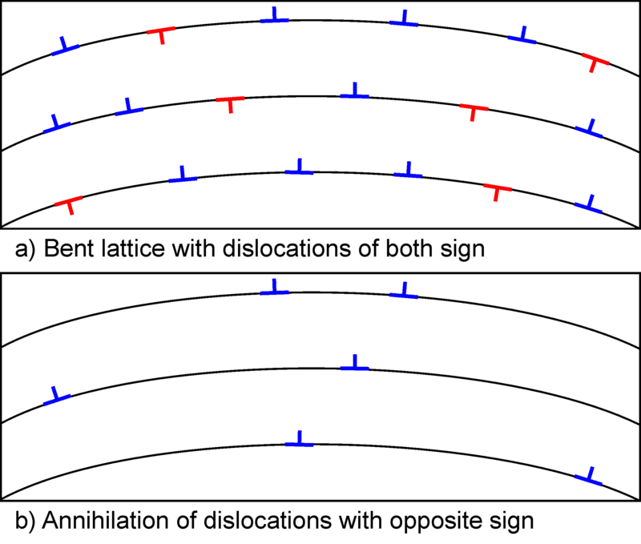
Recovery
Recovery is a process by which a metal or alloy's deformed grains can reduce their stored energy by the removal or rearrangement of defects in their crystal structure. These defects are primarily dislocations which are introduced by plastic deformation of the material and act to increase the yield strength of a material. Since recovery reduces the dislocation density, the process is normally accompanied by a reduction in a material's strength and a simultaneous increase in the ductility. As a result, recovery may be considered beneficial or detrimental depending on the circumstances.

Slide 31
Recrystallization is a process by which deformed grains are replaced by a new set of defect-free grains that nucleate and grow until the original grains have been entirely consumed. Recrystallization is usually accompanied by a reduction in the strength and hardness of a material and a simultaneous increase in the ductility. Thus, the process may be introduced as a deliberate step in metals processing or may be an undesirable byproduct of another processing step.

Slide 32
Super alloy strengthening
Superalloys are high-performance alloys designed to retain strength and resist deformation at elevated temperatures, especially in turbine engines and aerospace applications. Their strengthening is achieved through a combination of mechanism
Solid Solution Strengthening
Precipitation (γ′ strengthening): Formation of coherent precipitates (like Ni₃(Al,Ti)) that act as strong obstacles to dislocations
Dispersion Strengthening

